Slide 1


My Story About My Baby Brother,
Owen

Slide 2
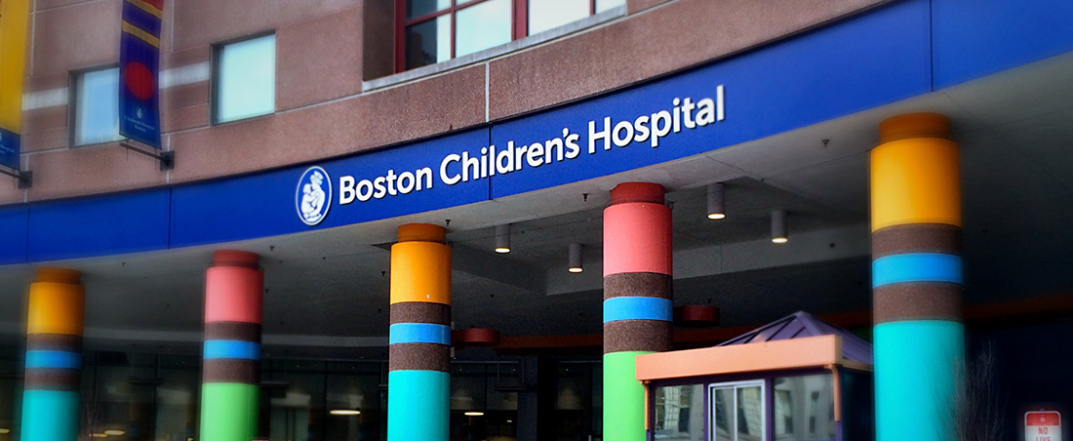
Owen is at Boston Children’s Hospital right now.
This is what the hospital looks like on the outside!

Slide 3
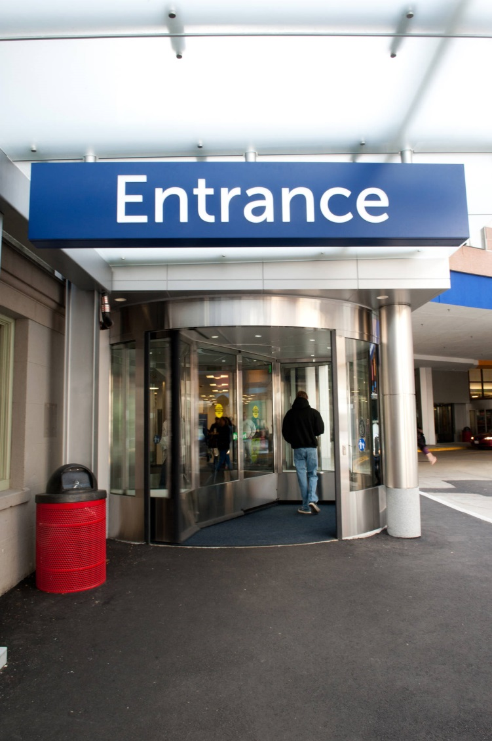
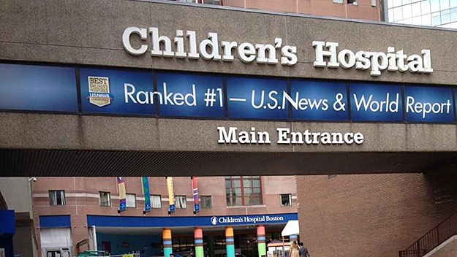

This hospital is
special because it’s just for
kids and babies.
Some kids are sick, some need surgery, and some are visitors!
Owen is sick.

Slide 4
We do not always need to go to the hospital when we are sick.
Since Owen is a new baby, he needs different help from doctors and different medicine than a big kid because his body is learning how to work and his body isn’t as strong as your body yet!

Slide 5
Here are some pictures of what the hospital looks like inside!

Slide 6
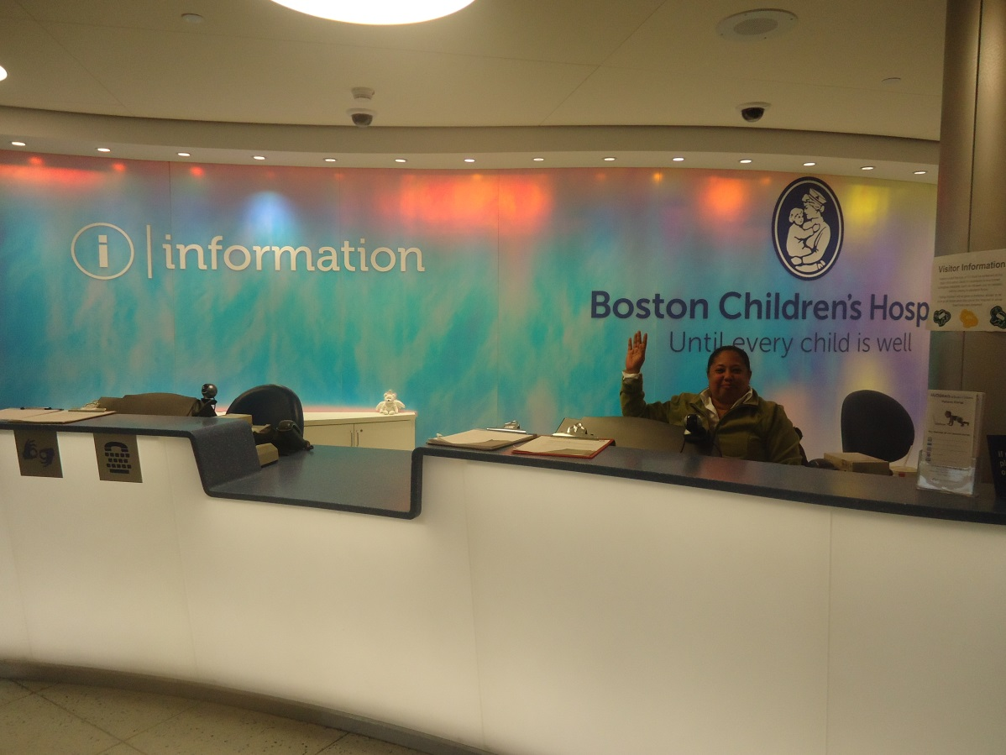
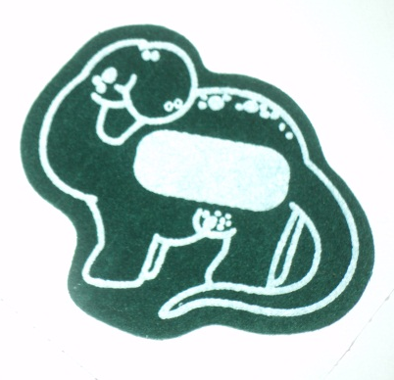
This is the first stop at the hospital.
When kids come to visit, they get a special dinosaur sticker!

Slide 7
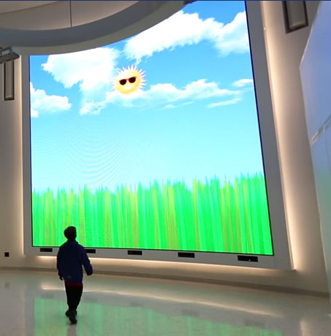
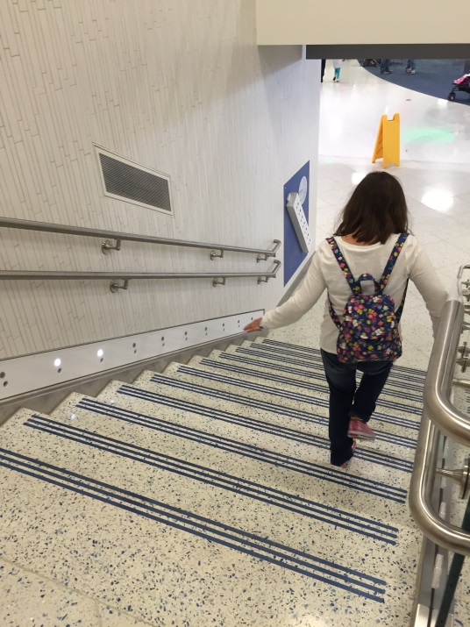
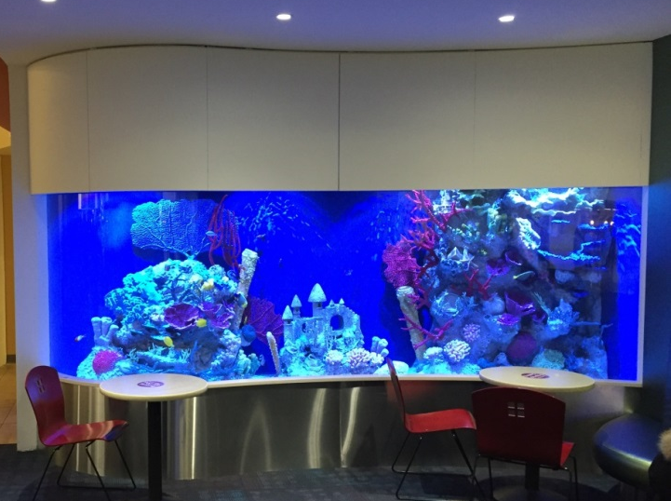
There are a lot of fun things to do at the hospital!
1. A big screen with moving pictures!
3. Stairs that make music!
2. A fish tank

Slide 8
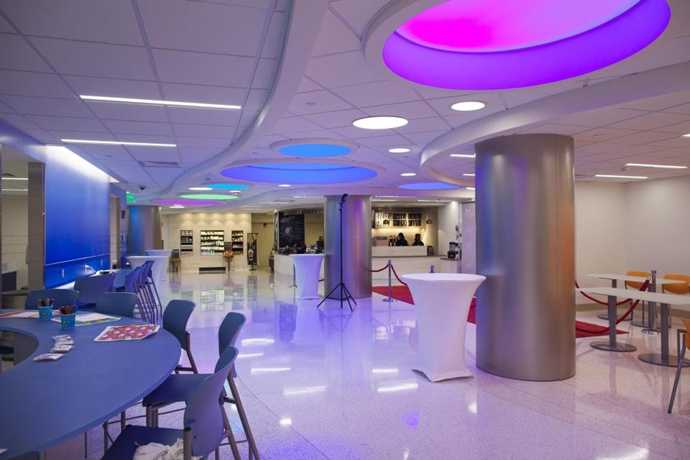
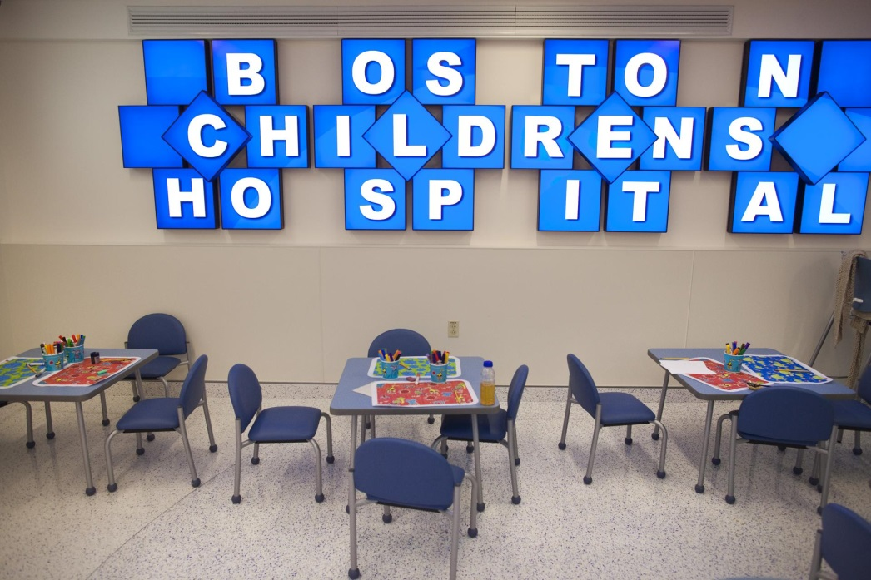
This is the cafeteria where I can eat.

Slide 9
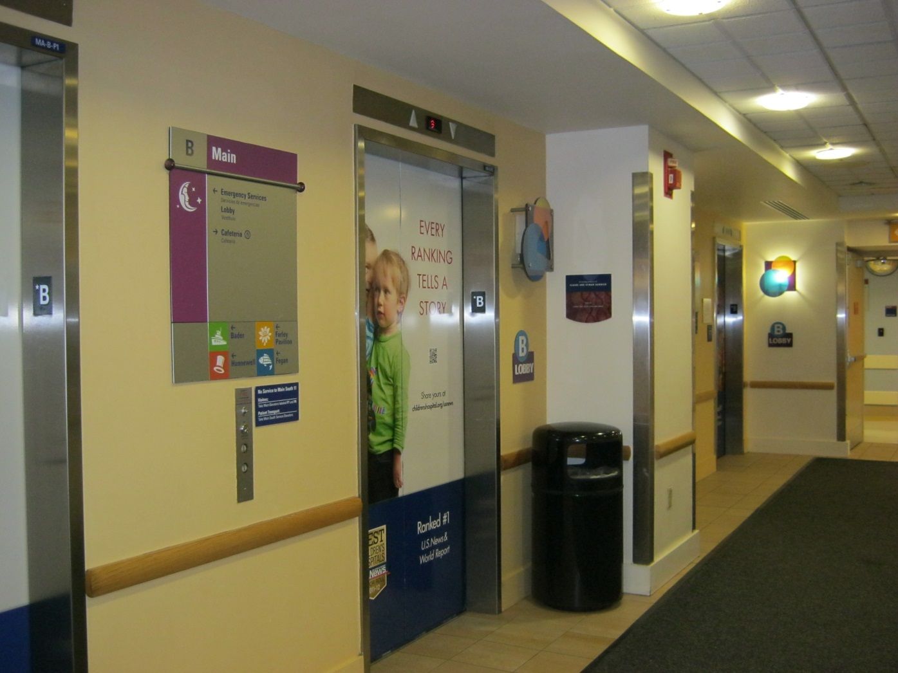
These are elevators that go all the way up to the 11th floor where Owen is staying!

Slide 10
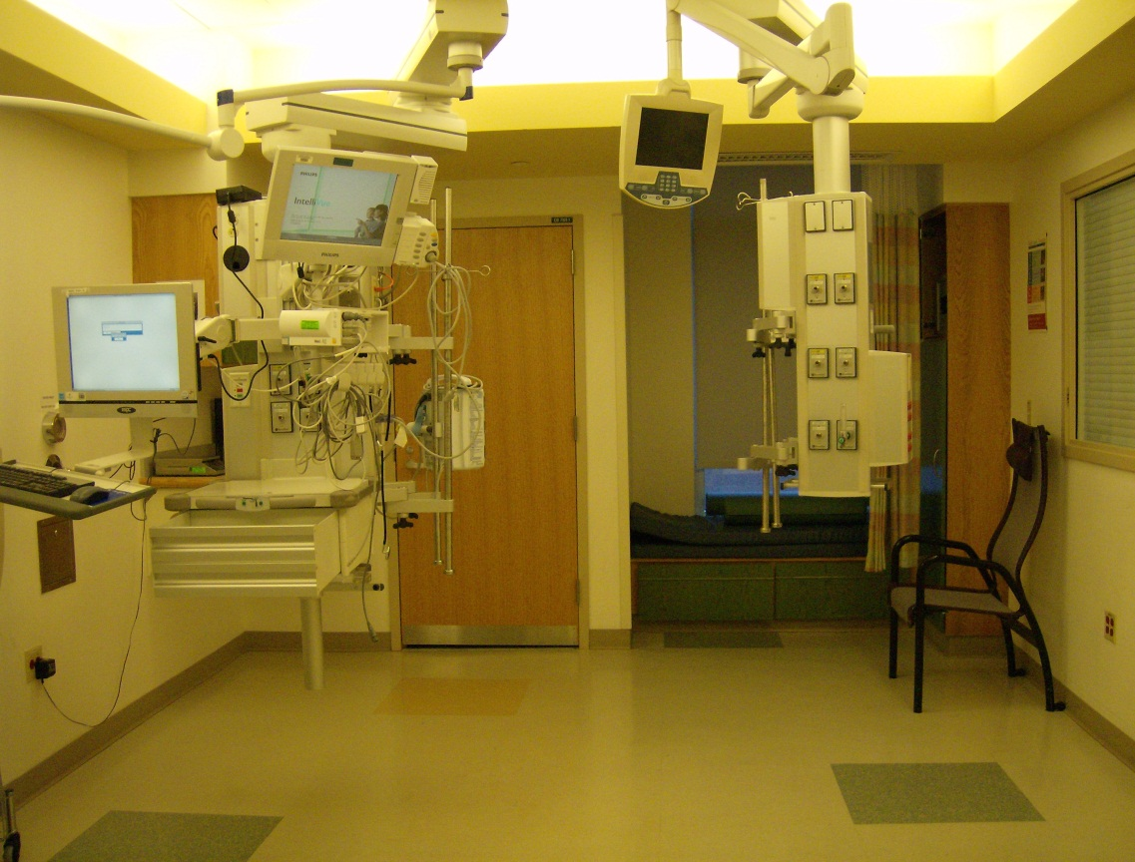
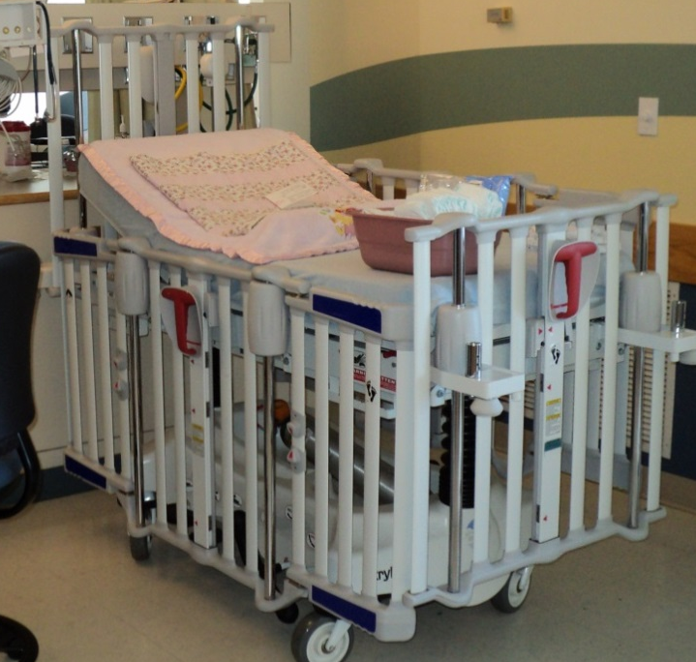
This is what Owen’s room and crib looks like.
There are a lot of machines that can make loud noises, but this just tells the doctors and nurses how Owen’s body is feeling.
This is where Mommy rests!

Slide 11

Right now, Owen needs to stay more nights in the hospital until he gets better and stronger! When the doctors and nurses say that he is better, he will go home to play with you again!

Slide 12
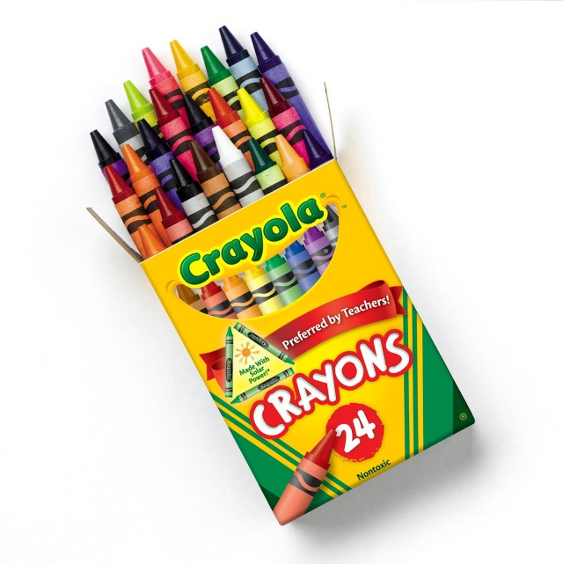
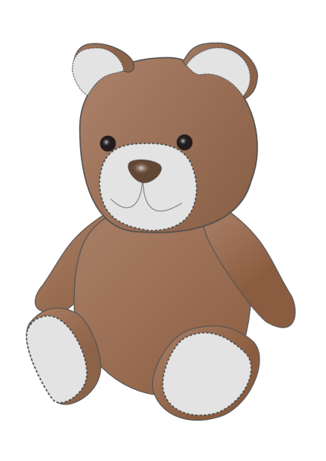
Some kids say that it can help to have a special job when they’re away from their brother or sister. Some kids like to draw a picture to hang in brother’s crib/room or pick out his favorite stuffed animal or book to send to him.
What do you think Owen might like?

Slide 13
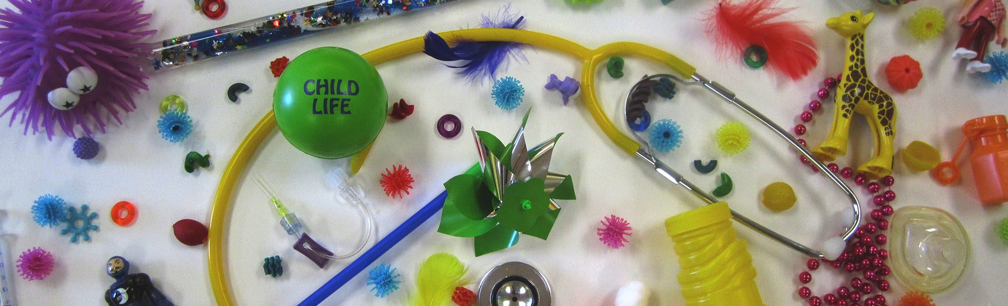
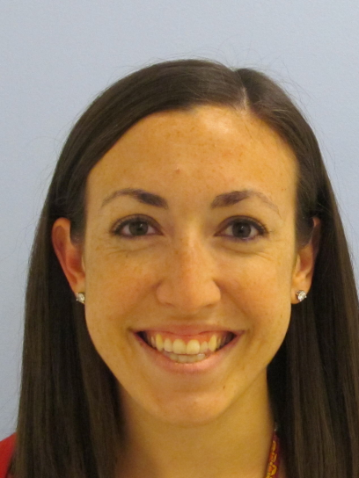
Hi! I am Jamie. I am the child life specialist that made this book just for you! My job is to bring fun to the hospital and help brothers and sisters understand what the hospital is like. If you feel scared or worried, have questions, or just want to play, I, or another child life specialist can help you!
If you come to visit, maybe I can meet you!

Slide 14
The End!

